Slide 1
PERMISSION BASED DETECTION OF ANDROID MALWARE
PROJECT GUIDE PRESENTED BY
DR.N SUDHAKAR M. YASASWINI
N.ANUPAMA
M.SREEVANI
K.POOJITHA

Slide 2
CONTENTS
ABSTRACT
EXISTING SYSTEM
PROPOSED SYSTEM
DESIGN
IMPLEMENTATION
RESULTS
CONCLUSIONS

Slide 3
ABSTRACT
Our project targets the detection of malicious Android apps by analyzing their requested permissions. By examining the permissions an app requests during installation, we can uncover potential malicious behavior.
We trained models to distinguish between benign and malicious apps based solely on their permission patterns.
Our findings show promising results, suggesting that permission-based analysis is a viable approach for Android malware detection, offering enhanced security for users against harmful applications.

Slide 4
Existing system
Existing system uses multi-level methodology.
First identify, extract permissions and prepared a dataset for training the model.
Further, Employed various machine learning models to categorize the Apps into their malicious or benign categories.
The model achieves high accuracies of malware detection i.e., 89.7% with SVM, 89.96% with Random Forest,89.7% with Naive Bayes.

Slide 5
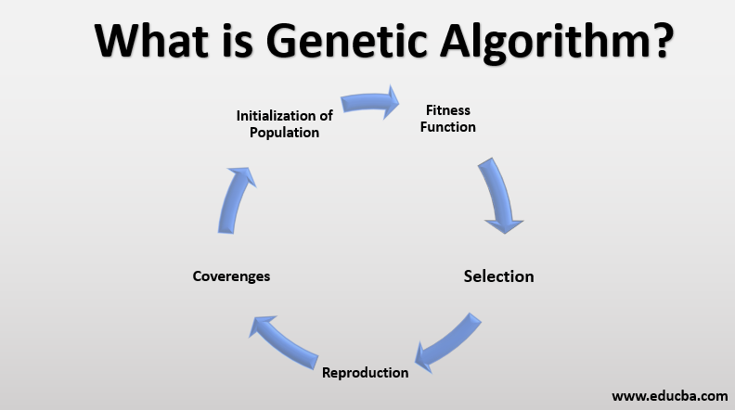
PROPOSED SYSTEM

Slide 6
PROPOSED SYSTEM
The solutions are evaluated based on their fitness, and the best ones are selected for reproduction.
The genes of the selected solutions are combined through crossover to create new solutions.
The genes of the new solutions are randomly mutated to maintain diversity.
The process is repeated until a stopping criterion is met, such as a maximum number of generations or a satisfactory fitness level.

Slide 7
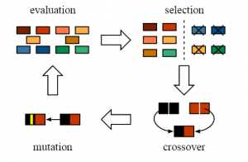

Slide 8
Proposed system
Model is trained with new dataset, which include more features for malware detection than existing model.
The dataset includes permissions as features like access_Bluetooth_share , access_cache_filesystem , send_sms,access_content_providers_externally , access_download_manager upto 400 permissions.
All the records have class labels as either malware or benign.

Slide 9
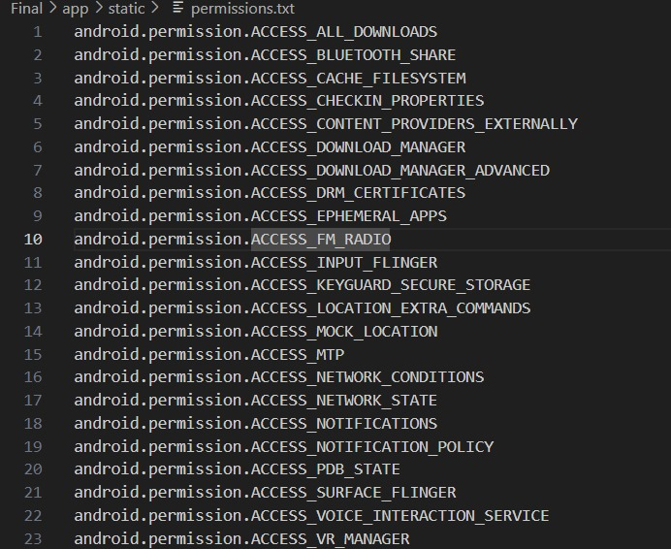

Slide 10
Proposed system
After ,The Feature set optimized using Genetic Algorithm.
Then , selected models are trained using optimized feature set and evaluated.
Finally, stakeholders can upload their APK files.
The model extract the permissions from APK file uploaded by user, compare those permissions with the permissions it get trained and detect whether it is malware or safe application.

Slide 11
Design
Collecting dataset with permissions as features.
Filtering, Finalizing, and Extracting the Permissions (Features) Dataset.
Employing support vector classifier and ANN algorithms that are optimised with the features selected by Genetic Algorithm.
Training the model and perfoming predictions.
Classifying whether the application is malware or benign.

Slide 12
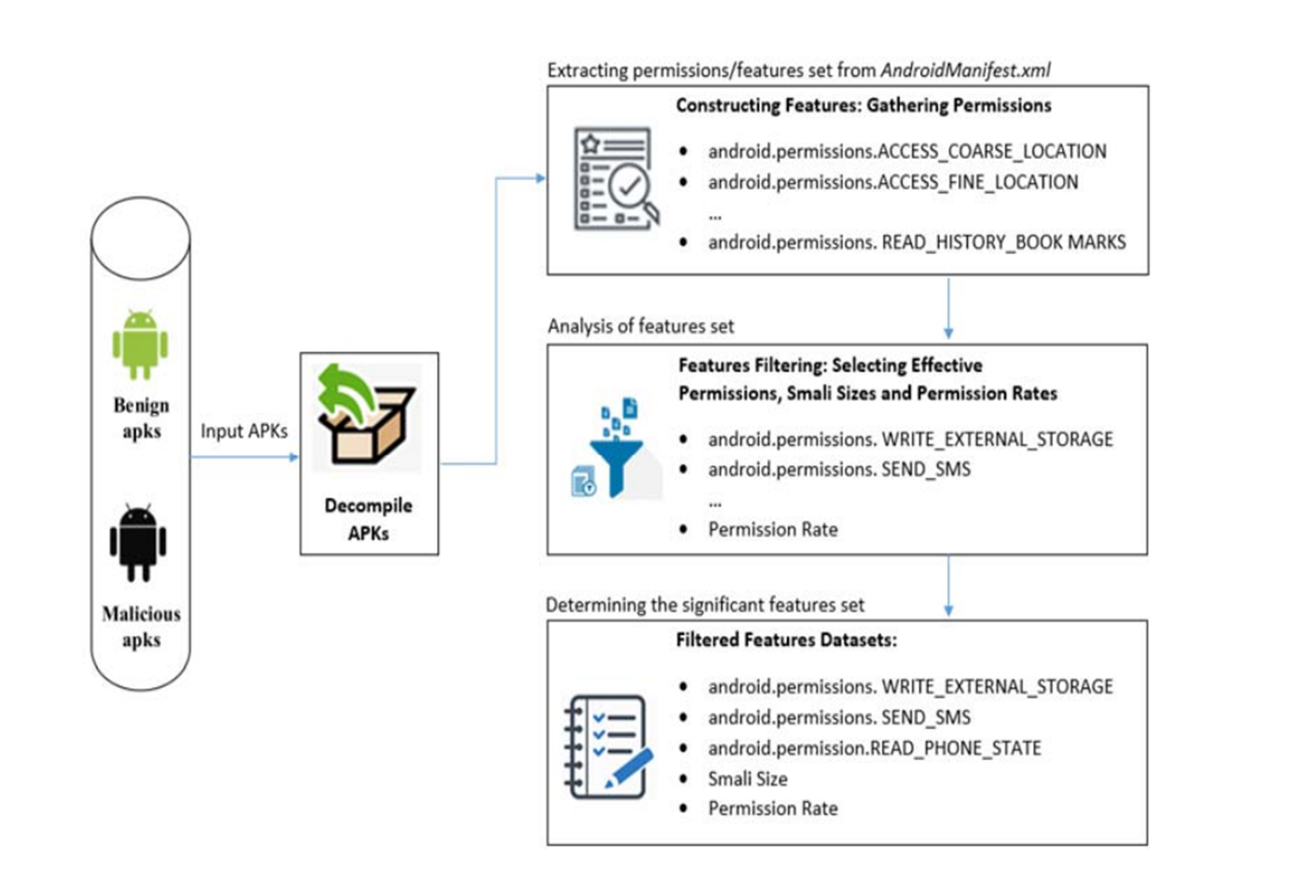

Slide 13
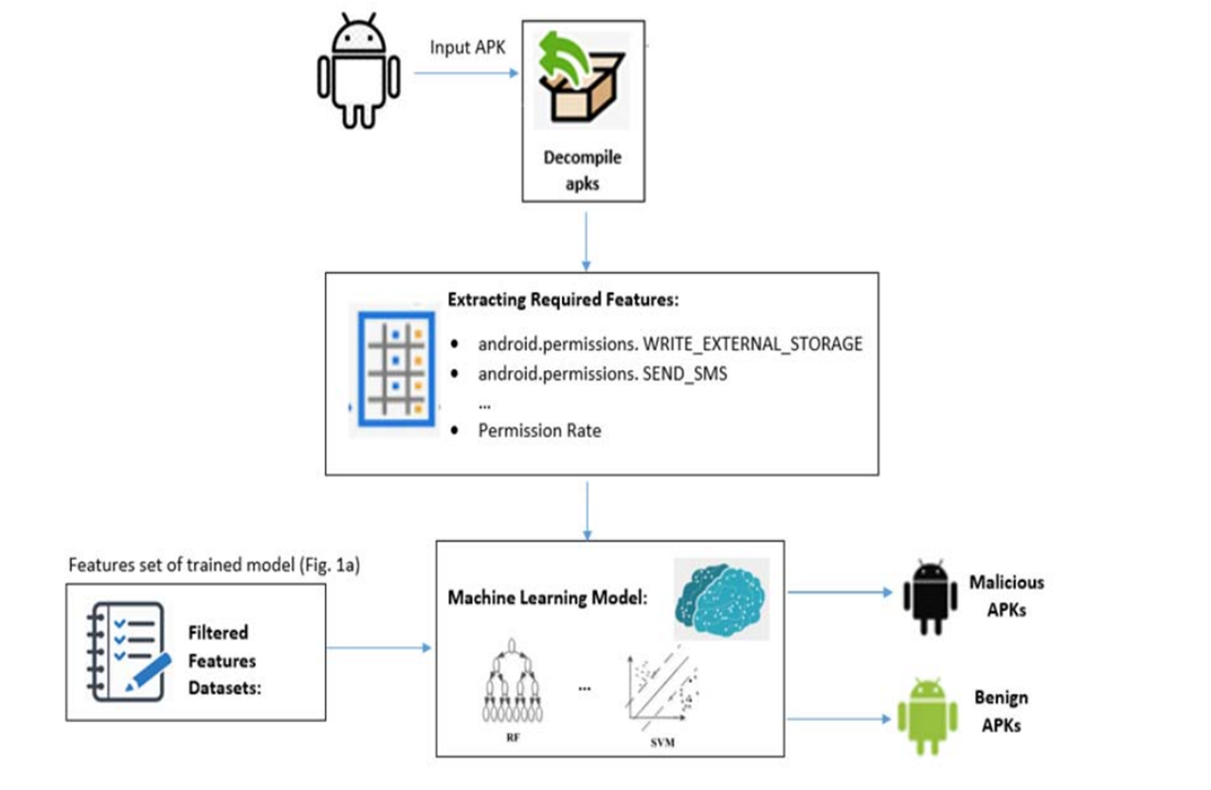

Slide 14
IMPLEMENTATION
Import all the necessary packages
Getting and performing data cleaning
Optimizing feature set using Genetic Algorithm
Loading dataset for Training the mode
Splitting data for Training and Testing
Training Section
Testing the model
Predictions and calculating Accuracy Metrics

Slide 15
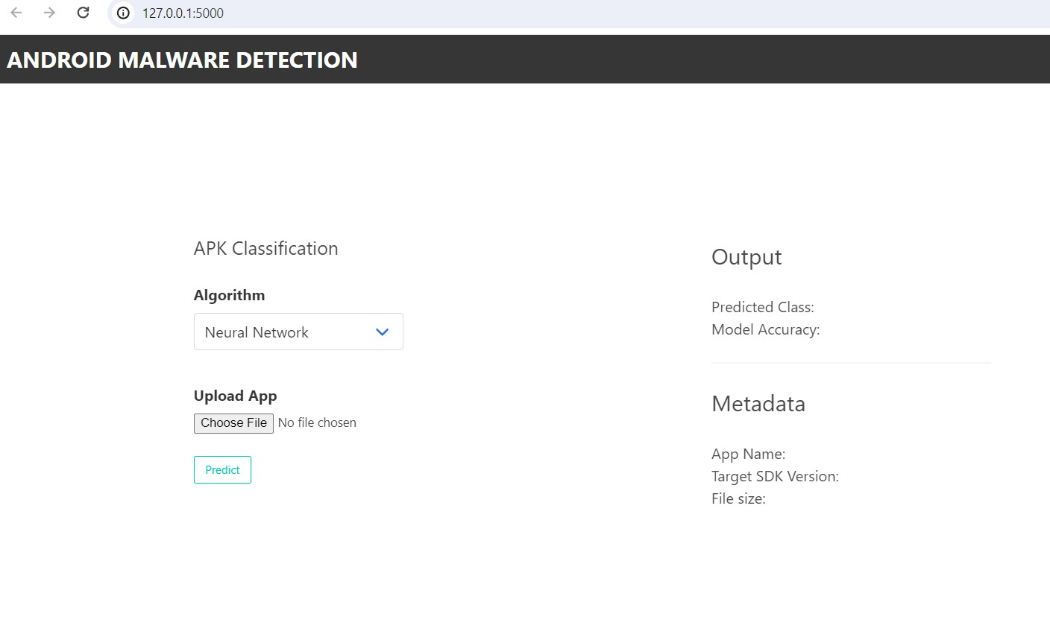
result
The Interface of home page looks like:

Slide 16
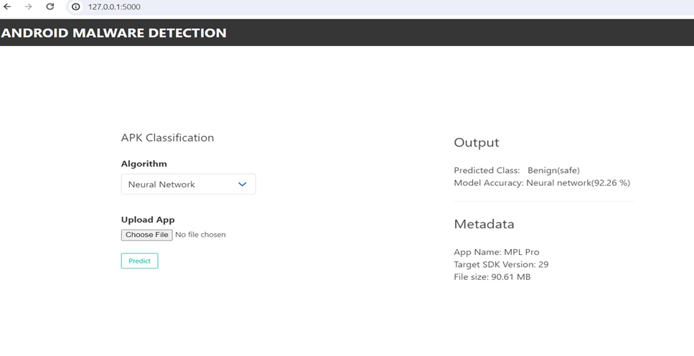
RESULT
User can Upload his APK file and predict whether it is malware or benign application.
Output when Safe application APK file is uploaded:

Slide 17
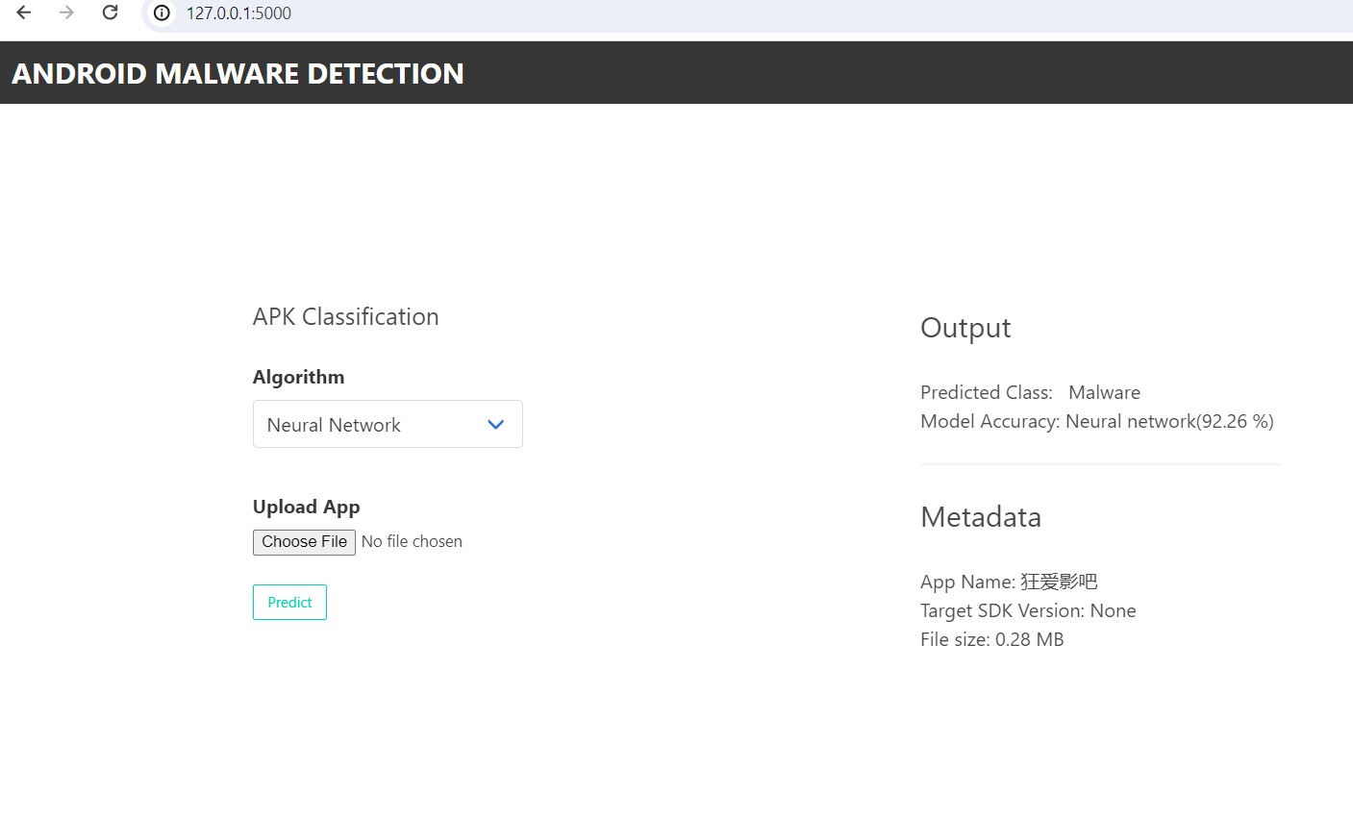
RESULT
Output when Malicious App APK file is uploaded:

Slide 18
CONCLUSION
Through rigorous feature extraction, model development, and performance evaluation, the system has demonstrated promising results in accurately classifying apps.
Project represents a significant contribution to the ongoing efforts to create a safer and more secure mobile environment for users.
By providing a reliable method for identifying and mitigating malicious threats, the project aims to safeguard user privacy and promote trust in the Android platform.

Slide 19


